Slide 1
IS54 Intellecutal Property Rights UNIT – II Patents
Ms. Evangeline D

Slide 2
Concept of Patent
Creative work of human mind can yield industrial development
Patent: Monopoly grant that enables the inventor to control the output and within the limits set by demand, the price of the patented products
First patent to promote culinary arts in Greece (Monpolien) around 500 BC
Patents in 14th and 15th century (Venice), 16th century (German kings)

Slide 3
Concept of Patent
1623 – Statute of monopolies – monopoly privileges to first and true inventor
Mid 17th century to mid 19th century – Europe and North America
Indian Patent System - 1856 – Patent and Designs Act (1911) – Provisions for product and process patents – More beneficial to foreigners
Amendment of 1911 Act in 1950 by Justice Dr. Bakshi Tek Chand – Food / medicine/ surgical devices available to public commensurate with giving compensation to patentee

Slide 4
Concept of Patent
Amendment in 1950 – Compulsory license for food, medicine and insecticide/fungicide
1957 – Justice N.Rajagopala Ayyangar – discussion on patents relationg to chemical inventions and food/medicine. New patent law in 1970 based on his report in 1959

Slide 5
Patent Act (1970)
Patent Act 1970 – In force for 24 years till Dec 1994
Patents for both patentee and public
Products vital for agriculture / horticulture, atomic energy inventions (non-patentable)
Many minor revisions – major revision in 2002 – increasing patent term to 20 years
Third amendment – 2005 product patent in all fields of technology

Slide 6
Patent Act (1970)
Exclusive right granted by country to owner of invention to make/use/manufacture/ market the invention adhering to law conditions
Can be inherited / assigned / sold/ licensed
State can revoke patents
Right is territorial and must be filed in each country of interest to the patentee
Valid for 20 years at present

Slide 7
Product / process patents
Product patent is for the product
Process patent – Patent is for process and not for product, Anyone can produce the same product using some other kind of process, less protection to the inventor
No product patent to medical/ surgical /treatment/food/chemicals
License of rights – Right to use invention for three years from date of filing

Slide 8
Duration of patent
Duration : 20 years (also in PCT)
Invalid after that period
Renewal fee must be paid after two years from expiry date
Six month extension for renewal
Quote patent number, fee and year while paying renewal fee
Can pay the fee in advance

Slide 9
Elements of Patentability
Patent for invention and not for discovery
Elements: Novelty, non-obviousness and utility
A totally new invention or an improvement of an invention / combination of different matters that yields a better product is patentable
Totally new invention – Not mentioned in any publication or adopted anywhere else in the world – inventor is the first one to adopt

Slide 10
Novelty
An invention is not considered novel if
It is anticipated in any publication before filing on or after January 1, 1992
It is anticipated by publication made before date of filing in any country
It is claimed in any specification before filing but published after filing
It is used by local community in India or elsewhere even if there is no written proof

Slide 11
Non -obviousness
Technically advanced than existing knowledge / having economic growth
A product or process is obvious if it is already known to “person skilled in art”
“person skilled in art” – an ordinary practitioner who holds general common knowledge in the relevant art at relevant date.
Can be a single person or group of persons

Slide 12
Utility
An invention in industry
- Can be made, Can be used in any activity
Can be reproduced with same characteristics
An invention must be useful; need not be a commercial success; following directions of use gives desired result mentioned by applicant; useful for purpose mentioned by applicant; even if improved invention is available, existing patent is not obsolete; imaginary uses not considered

Slide 13
Non-patentable Subject Matter
1. An invention contrary to natural laws
2. Causing harm to humans/ plants/ animals
3. Discovery of scientific principle / discovery of living or non-living substances in human nature
4. Discovery of a substance that does not lead to improved efficacy
5. Combination of compounds with combined properties
6. Duplication of known devices

Slide 14
Non-patentable Subject Matter
7. Inventions omitted by Patents (Amendment) Act, 2002
8. Agriculture / horticulture method
9. Medicinal/ surgical/ therapeutic procedure for humans and animals
10. Plants/ animals/ seeds/ species other than micro-organism
11. Computer programs/ set of hardware components
12.Literary/ dramatic/ musical/ artistic work

Slide 15
Non-patentable Subject Matter
13. Performance/ Act/ method of playing a game
14. Presentation of information
15. Integrated Circuits
16. An invention that incorporates traditional knowledge
No invention related to atomic energy can be patented

Slide 16
Questions to the students
A torch having an alarm clock
A new species of butterfly found in western ghats
A new way of illuminating room for better photography
A software which can recommend the hotels to users based on their online behavioural patterns
An ayurvedic massage technique to quickly relieve back pain

Slide 17
Questions to the students
A new hairstyle.
A makeup kit and process which makes the wearer look younger.
A kind of grass in Himalayas which can cure cancer.
A software for preparing timetable in colleges.
A smart device and software for detecting unlawful activities.

Slide 18
Questions to the students
Fan with light.
Mechanical car cleaning device.
Pizza with health benefits.
New star near Pluto.
App which auto-dials ambulance on emergency.
Self-driving cars.
Electric perfume sprayer.
Smart drainage block detector.

Slide 19
Questions to the students
New form of salsa dance.
Hat with torch.
New breed of dog.
Process for finding shortest route from one city to another.
Printer which accepts files through Wi-Fi.
An intelligent automobile that initiates payment in toll booths.
Method for sowing seeds automatically.

Slide 20
Questions to the students
Computer program without hardware.
Device for executing humans.
Compounds of an earlier patented medicine.
Live human-made microorganism.
A chemical which makes a tennis ball to move upwards when dropped from 100 meters height.
An apparatus and method to increase the yield of paddy in low rainfall regions.

Slide 21
Questions to the students
A novel method to display important information to students in college notice board.
A process to reduce the time of radioactive fusion in nuclear reactors.
A device to optimally capture moving images in wearable instruments and a procedure to identify and process the known objects in them.

Slide 22
Application for Patent
Patent can be filed by
i. True inventor of invention -> Not the first importer/ someone to whom invention is first communicated outside India
ii. Assignee of person -> Can be a person/ research organization/ educational institute
iii. Legal representative of deceased inventor ->Estate of the deceased

Slide 23
Form of Application
Patents for exclusive invention
In case of assignment of patent rights, details of proof of right must be provided
Patent application must mention product/ process patent
International application under PCT may be filed designating India -> Filing date of application -> international filing date
International application valid in 120 countries
Customization of patent in 1 or group of countries – citizens / resident of PCT countries

Slide 24
Specification
Invention must be disclosed in the complete specification so that person skilled in art may be able to perform the invention
Techno-legal document
Specification -> Complete / provisional
Must be submitted in Form2 with Form1+fee
First page of Form2 -> Title of invention; name, address & nationality of each applicant; preamble to the description
Title – specific features of invention

Slide 25
Specification
Necessary drawings with references in the specification
Models/ samples related to invention – not part of specification

Slide 26
Provisional Specification
Inventor discloses his invention in written form on paper and submits to patent office – priority date and number
Complete specification within 12 months from date of filing of provisional specification
If not filed, abandon application. Also, 3 month extension period.
Two cognate specifications – one complete specification can be filed
Second related specification given date of filing of earliest provisional specification

Slide 27
Provisional Specification
Can convert complete specification to provisional specification – Rewrite date of filing as date of filing of complete specification
Complete Specification: Techno-legal document; extremely important in patent proceedings; Should be drafted without ambiguity

Slide 28
Significant Features – Provisional Specification
Filed when one is in process of finalizing his invention
Only a general description, field of invention and anticipated results
No claims
To fix priority date (Date of filing to protect claims in provisional specification)

Slide 29
Important Elements of Complete Specification
A. Fully and particularly describe the invention – Operation, use and method
B. Best method of performing the invention
C. Scope of the invention
D. Abstract – technical information of the invention
Deposit of biological material – International Depository Authority
Controller may amend abstract for providing better information about biological material

Slide 30
Important Elements of Complete Specification
Application may be completed by depositing material to International Depository Authority under Budapest Treaty with following conditions
Deposit of the material not later than date of filing of patent application
Characteristics of the material must be mentioned - Also include name, address of depository institution, date & no. of deposit
Access the material after date of filing or if priority is claimed after date of priority
Source and geographical origin of biological material in the specification

Slide 31
Important Elements of Complete Specification
International Application designating India – Title / Description / Drawings / Abstract / Claims
Additions to invention

Slide 32
Important Elements of Complete Specification
Three types of claims
Main Claim – Invention in broadest possible terms
Subordinate Claim – Additional feature of invention
Omnibus Claim – An arrangement as shown in diagrams

Slide 33
Principles of Construction of specification
Novelty explained
Legal limits of the monopoly granted
Clear and unambiguous claims
Meaning of specification addressed to person skilled in art
Court can call expert for advice
No other document other than the specification to plead invalidity is not permitted
Meaning of claim must be same for infringement or challenging the invalidity

Slide 34
Types of Patent Applications
1. Ordinary Application – Does not claim any priority of application/ refer any other application in patent office
2. Convention Application – Claims priority date based on similar application in one of the convention countries
3. PCT Application – Application governed by PCT and valid in 142 countries
4. Divisional Application – application includes more than one invention
5. Patent of Addition – Slight modification of the invention – Expires with parent application

Slide 35
Where to Apply?
In which patent office, filing is done?
Place of residence of applicant
Where invention actually originated
Address for service in India
Foreign applicant – Patent Agents’ address

Slide 36
Questions to the student
Priority date
Differences – Provisional and Complete
Claim
Types of Application
Types of claim
https://www.allindianpatents.com/patents/211651-home-automation-and-security-system-using-gprs-mobile-phone
https://patents.google.com/patent/WO2016095117A1/en

Slide 37
Transfer of Patent Rights
Assignment
Licenses
Transmission by Operation of Law

Slide 38
Assignment
Transfer by a party of all of its rights or interest in property (Made by agreement)
Assignment : Transfer of interest (Whole or part of patent rights)
License – Privilege to do some particular act which licensee can perform

Slide 39
Assignment
Assignment Three types are legal, Equitable and Mortgages.
Legal: Assignment of existing patent through an agreement that is duly registered.
Equitable: Any document other than agreement to transfer rights to another person with immediate effect.
Mortgage: Allowing patent rights wholly or partially to mortgagee with a view to secure payment of specified sum of money

Slide 40
Conditions to create a valid assignment
Assignment reduced to writing in a document containing all terms and conditions regarding rights between both parties
Written agreement duly registered under Indian Patent Act
Assignment – Written document registered at Controller Office within 6 months

Slide 41
Patent Assignment – A Case Study
The acquisition of Oculus VR by Facebook is a perfect example of this: in 2014, Facebook bought the VR company for around $2 billion. In the deal, Facebook also acquired all of the patents. Facebook’s focus on VR was a significant moment: today, VR technology is one of the most active patent-wise. This activity is not just limited to the gaming sector, the following industries have also experienced increased activity:
Medicine;
Data visualization;
Aviation;
Military;
The treatment of mental illnesses.
The acquisition by Facebook proved to be a clear signal that:
Facebook was likely to invest heavily in the development of VR technologies;
The VR industry was going to be popular in the near future.

Slide 42
Licensing
Licence of Patents: Transfer of patent rights to make, use or exercise the invention
Four types are Voluntary, Statutory (Ex: Compulsory), Exclusive/limited and Express/implied
Voluntary: Written authority granted by patent owner to another person to make / use / sell the patented article
Statutory: The Controller and Central Government play an important role in determining the terms and conditions
Exclusive / Limited: While exclusive licence gives all exclusive rights, limited licence imposes certain limitations

Slide 43
Licensing
Express / Implied: While express licence gives permission to use patent in express terms, implied licence gives permission implied from circumstances

Slide 44
Licensing - Advantages
A company not interested in manufacturing can also license out
Well-established companies can make it possible for an enterprise to reach the market faster with innovative technology
Company without resources for R & D can gain access to technical advances necessary to provide new or superior products
Licensor retains ownership of the property and licensee reaps economic benefits

Slide 45
Patent Licensing – A Case Study
Ericsson is a company that mainly deals with communication service. The company portfolio consists of Network, Digital Services, Managed Services and Emerging business. It helps its customers to be digitalised which will increase their efficiency.
Oppo being a global leading smart device brand, has been relentlessly working towards in the pursuit of aesthetic satisfaction and innovative technology. It has total number of 40,000 employees, and it is working in 30+ countries and regions and has 6 research institutions and 4 R&D centers worldwide.
Recently they entered into a Global Patent license agreement. This agreement covers cross license covering 2G, 3G and 4G patent portfolios from both the companies. Besides, cross-license, the agreement also includes business cooperation on a number of projects related to 5G such as device testing, customer engagements.

Slide 46
Transmission by Operation of Law
When patentee dies, patent rights pass to his legal representative. Patent can be acquired by Government under certain reasonable conditions.

Slide 47
Registration of assignment or license is essential
Assignment or license is valid only if in writing and registered with Controller of Patents
Only if registered – Action can be taken by High Court or Controller in case of infringement
To sue for infringement, title of person must be mentioned

Slide 48
Certain restrictive conditions to be avoided
Patentee can compose certain restrictions on license. Eg: Do not use competitor’s product
Restrictions that cannot be imposed:
Patentee cannot ask the licensee not to acquire / use some other article from others
Same applies to process also

Slide 49
When a restrictive condition can be imposed
A patentee can restrict licensee from selling competitor’s product. Spare parts for repairing patented product must be purchased only from patentee

Slide 50
Revocation and Surrender of Patents
Central govt will not disclose any patent information concerned with nation’s security
Patent misleads any State or public. Patentee must be informed before revocation
Invention relating to Atomic Energy may be revoked
Patented invention not available to public at reasonable price (Sec 89)
Patentee does not give rights to Govt on reasonable terms
Some interested person gives petition

Slide 51
Revocation of patents
Three elements of patentability
Invention – Claim in already present specification
Patent granted to person not entitled to apply for patent
Patent obtained wrongfully
Complete specification does not describe the invention
Scope of claim – not in specification
Patent obtained on false representation

Slide 52
Revocation of patents
Subject of claim - not patentable
Invention – Secretly used in India
Applicant has disclosed secrets of Central Govt
Amendment by fraud
Geographical origin of biological material – Not or wrongly disclosed
Invention already in use by local community

Slide 53
Questions to the students
Automatic locks for rooms
New species of panther in Gir Forest
Microorganism that can reduce the sourness of curd
Musical notes of music album
Smell of chocolate cakes

Slide 54
Questions to the students
Water metering built-in pipes
Waste recycling machine to segregate degradable and non-degradable wastes
New dosa recipe
Nuclear reactor with less emissions
Purse with first aid kit

Slide 55
Questions to the students
Pen with knife
Computer mouse with pen
Spoon that detects microbial presence
Eyewear for common man to view microbes
Mobile charger that notifies with alarm tone on full charge
Fertilizer that gives high yield for rice
Smart fabric suitable for all weather

Slide 56
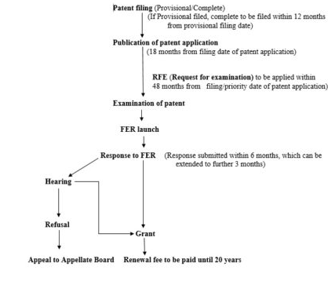

Slide 57
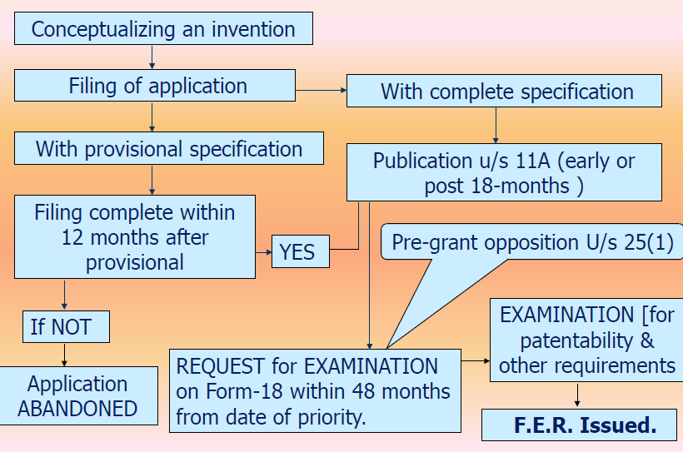

Slide 58
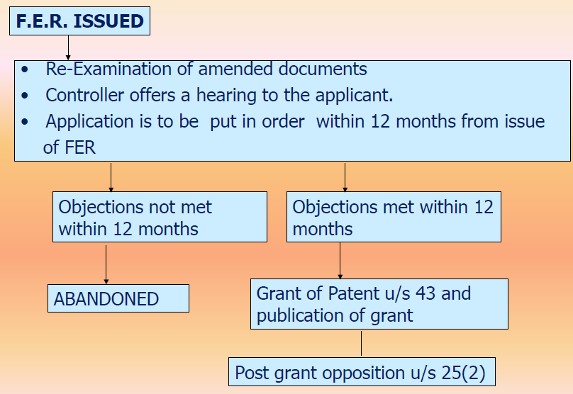

Slide 59
Pre Grant Opposition:
The provisions for pre grant opposition is provided in Section 25(1) of the Patent (Amendment) Act 2005. An opposition can be filed by any person by offering a representation to the controller general of patents at an office falling in appropriate jurisdiction. A Patent is not granted before the expiry of six months from the date of publication hence a person may file pre grant opposition within the assured period of six months from the date of Publication as this ensures that the pre grant opposition may be filed for sure. The opposition request includes a statement along with an evidence to support the opposition.

Slide 60
Pre Grant Opposition:
The controller is entitled to consider the pre grant opposition application only upon a request for examination being filed. The statement issued along with the examination report is considered while hearing the pre grant opposition. In case the examiner feels that the arguments put forward are not of any merit for opposing the grant of patent then the opposition is rejected by issuing a speaking order within one month.

Slide 61
Pre Grant Opposition:
On the contrary if the examiner finds the opposition to be in merit then, the applicant is notified along with a copy of the representation. The applicant may reply accompanied by any supporting evidence within three months from the date of the notice.
The Controller shall consider the statement and evidence filed by the applicant and in turn grant or refuse the patent or may suggest amendments in the claims of the complete specification. Based on the proceedings the controller may proceed with either grant or rejecting the patent application. Either will be communicated to the applicant.

Slide 62
Post Grant Opposition:
Anyone can file an opposition to the granted patent in a format prescribed by the patent office within twelve months of the grant of a patent in duplicate. It is mandatory for the opponent to clearly state the interest with respect to the invention which is prompting for filing an opposition. The provisions for post grant opposition is provided in Section 25(2) of the Patent (Amendment) Act 2005.

Slide 63
Post Grant Opposition:
The opponent may include any person involved in a research pertaining to the same field as the invention. Also an organization having financial or trading interests with respect to the patented invention may apply.

Slide 64
Post Grant Opposition:
Post receipt of the opposition application the patentee is notified with immediate effect. The opponent is expected to deliver any statement of evidence with this regard. Similarly on receipt of the evidence the patentee is allowed to submit any evidence in support of the patent. The prescribed time limit is twelve months from the date of the of the copy of opponent‘s written statement and evidence (if provided).

Slide 65
Post Grant Opposition:
Another chance is provided to the opponent to deliver further evidence opposing the patent within one month of receipt of the support documents from the patentee. Based on the evidence from both the patentee and opponent a date of hearing is fixed up. The hearing is taken up by the opposition board constituted by the controller comprising of three members with one chairman. The examiner may or may not be a member of the board. Based on the evidences from both the parties a recommendation is proposed by the board. A notice for the hearing is given to both the parties at least 10 days prior to the hearing date. A prescribed fee is to be submitted by the party intending a hearing.

Slide 66
Post Grant Opposition:
The hearing from both the parties in combination with the opposition board’s recommendation decides whether the patent’s grant is accepted or revoked or requisite amendments in the specification may be ordered by the controller.

Slide 67
Patent Database and Patent Information System
Intellectual Property Office in India is dedicated to mobilize the use of technological advancement for socio-economic development, by creating the requisite IP culture.
The Office of the Controller General of Patents, Designs & Trade Marks (CGPDTM) is responsible for the administration of Patents Act, 1970, Designs Act, 2000, The Trade Marks Act, 1999 and Geographical Indications of Goods (Registration and Protection) Act, 1999 through its Intellectual Property Offices located at Mumbai, Delhi, Kolkata, Chennai and Ahmedabad.

Slide 68
Patent Database and Patent Information System
Patent information is more than just technological or legal information. When developing a new product, comparative technological information may determine the success or failure of the product and, in turn, the success or failure of the company itself.

Slide 69
Patent Database and Patent Information System
An important step before filing a patent application is to conduct a patent search.
A patent search is a search conducted in patent databases as well as in the literature available to check whether any invention similar to inventor’s invention already exists.

Slide 70
Patent Database and Patent Information System
Many national and regional patent offices provide free online access to their own patent collections as well as to selected patent documents from other offices.
A number of commercial and non-profit providers also offer free patent information databases online.

Slide 71
Patent Database and Patent Information System
Intellectual Property Rights (IPR) are considered to be the backbone of any economy and their creation and protection is essential for sustained growth of a nation.
The intellectual property rights are now not only being used as a tool to protect the creativity and generate revenue but also to build strategic alliances for the socioeconomic and technological growth.

Slide 72
Patent Offices in India
The Office of the Controller General of Patents, Designs & Trade Marks (CGPDTM) comes under the Department of Industrial Policy and Promotion, Ministry of Commerce and Industry.
Of late, the office of the Controller General has also been known as Intellectual Property Office (IPO). The Office is responsible for the administration of Patents Act, 1970, Designs Act, 2000, The Trade Marks Act, 1999 and Geographical Indications of Goods (Registration and Protection) Act, 1999 through its Intellectual Property Offices located at Mumbai, Delhi, Kolkata, Chennai and Ahmedabad.

Slide 73
Patent Offices in India
The Office of the Controller General of Patents, Designs & Trade Marks (CGPDTM) is located at Mumbai.
The Head Office of the Patent office is at Kolkata and its branch offices are located at Chennai, New Delhi and Mumbai.
The Trade Marks registry is at Mumbai and its branches are located in Kolkata, Chennai, Ahmedabad and New Delhi.

Slide 74
Patent Offices in India
The Design Office is located at Kolkata in the Patent Office. A Geographical Indications Registry has been established in Chennai to administer the Geographical Indications of Goods (Registration and Protection) Act, 1999 under the CGPDTM.

Slide 75
Patent Offices in India
The Controller General supervises the working of the Patents Act, 1970, as amended, the Designs Act, 2000 and the Trade Marks Act, 1999 and also renders advice to the Government on matters relating to these subjects.
Mr. P.H. Kurian was the first IAS officer to serve as Controller General.

Slide 76
Patent Offices in India
The Patent information System (PIS) and National Institute of Intellectual Property Management (NIIPM) located at Nagpur also come under the superintendence of CGPDTM.
PIS maintains a comprehensive collection of patent specifications and patent related literature on a worldwide basis to meet the need for technological information of various users in R&D establishments, Government Organizations, Industries, Business, Inventors and other users enabling them to take informed business decisions.

Slide 77
Patent Offices in India
National Institute for Intellectual Property Management (NIIPM) as a national centre of excellence for training, management, research, education in the field of Intellectual Property Rights related issues, caters to the training of Examiners of Patents and Designs, Examiners of Trademarks & Geographical Indications, IP Professionals, IP Managers in the country, imparting basic education to user community, government functionaries and stakeholders involved in creation, commercialization and management of intellectual property rights.
The institute will also facilitate research on IP related issues including preparation of study reports and policy analysis of relevance to Government.

Slide 78
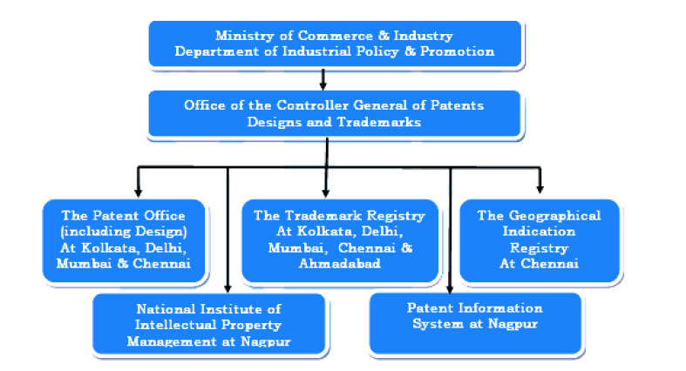
Patent Offices in India

Slide 79
Patent Information
In recent years, economists, social science researchers, policymakers, businessmen and professionals have begun to make increasing meso-level and macro-level use of patent information.
This is being done to analyze, for example, patenting activities of a country‘s technical patterns of internationalization; patenting activities in a sector, technology or company to ascertain or forecast the direction of technical change, or ascertain the relative technological position of a company in a marketplace; etc.
As such, the use of patent information has expanded to many different tactical and strategic business, research, and policy making activities at national, institutional or enterprise levels.

Slide 80
Patent Information
Patent information includes not only the content of published patent documents but also bibliographic and other information concerning patents for inventions, inventors’ certificates, utility certificates and utility models.
Patent applications are filed in accordance with the requirements of national or regional patent laws. An applicant may be a public and private company, government agency, researcher in a university or in a research and development institution, or even individual inventors.

Slide 81
Reasons for using patent information
Tool for Creative Thinking
Input for Licensing Strategy
Supporting Mergers and Acquisitions (M&A)
Guiding Management of Research and Development (R&D)
Human Resources Management

Slide 82
Tools for Creative Thinking
A specific methodology developed on the basis of
patent information is the TRIZ methodology (Russian acronym for Theory of the Solution of Inventive Problems).
Based on the study and analysis of a set of worldwide patent documents, Genrich Altshuller and his colleagues developed the TRIZ methodology. Starting in 1946, TRIZ began with the hypothesis that there are universal principles of invention that are the basis for creative innovations which advance technology, and that if these principles could be identified and codified, they could be taught to people to create or enhance their inventive capabilities.

Slide 83
Tools for Creative Thinking
TRIZ is currently being applied internationally to create and to improve products, services and systems. Large and small companies, including many Fortune 500 companies are using TRIZ on many levels to solve real and practical problems and to develop strategies for the future of technology.
Patent information, therefore, provides an extremely useful source of information for learning and developing creative problem solving and innovation strategies

Slide 84
Input for Licensing Strategy
When considering “licensing in” of technology owned by others, “licensing out” owner’s technology or “cross-licensing” between two patent portfolio owners, the concerned parties must collect reliable information on the target or key technology in order to take the right decision.

Slide 85
Input for Licensing Strategy
While preparing to ‘licensing in’ of technology, analyze patent information to consider:
• whether the technology in question is in the public domain in your target market due to its nonprotection, expiration, non-payment of maintenance fee or invalidation of the patent in a court proceeding;
• whether there is a possibility of someone else bringing an action for infringement against you to make you liable for payment of any damages;
whether the technology is overvalued or undervalued by comparing it with other related or alternate technologies, etc.

Slide 86
Input for Licensing Strategy
While preparing to ‘license out’ your technology, analyze patent information to consider:
• who could be prospective licensees in the marketplace;
• how valuable is your technology in order to prepare an attractive offer; and
• whether it is a core technology in your business, which if licensed out might become an obstacle to continue to practice this technology, etc.

Slide 87
Input for Licensing Strategy
‘Cross-licensing’ is an exchange between two companies to license one or more patents to each other, which gives the companies the freedom to operate; that is, without any fear of being accused of violating the patent rights of the other party.
Let us say that Company X is negotiating with Company Y. If Company X argues that its portfolio is more valuable than that of Company Y, it may require
Company Y to fill the gap in the form of one time or recurring payments. Here, patent analysis plays a role in comparing the patent portfolios of the two companies and in identifying key patents, so that it can help to decide who should pay whom and how much.

Slide 88
Supporting Mergers and Acquisitions
If a company wishes to acquire a specific technology along with other complimentary assets and has no idea from where to obtain it, then it first needs to identify all the companies with relevant patents and related assets.
A patent search help to identify all of the patents related to the area of interest. Once one or more potential target technologies/companies are identified, then the company can undertake additional patent analysis to narrow down its choices to decide which of the companies is the best merger or acquisition target.

Slide 89
Supporting Mergers and Acquisitions
Once a company identifies a target company, patent analysis can also address additional issues such as:
Is the target’s technology as good as it is claimed to be?
Is the company priced fairly?
Who are the key inventors and will they stay with the merged or acquired company?

Slide 90
Guiding Management of Research and Development (R&D)
Patent analysis makes it possible to find out the flow of technology from elementary technologies along with the expansion of those technologies, the trend of technological change, the life cycle of a technology (consisting of growth, development, maturity and decline), problems and solutions in the development of a particular technology, competitors’ technologies and solutions to cope with possible problems.
Knowing the life cycle of a technology makes it possible to judge the timing of development policy and focus on certain development themes.
It can also prevent an infringement from occurring, which would save a huge amount in litigation expenses and compensation for damages.

Slide 91
Human Resources Management
It has been repeatedly shown that a small number of highly prolific inventors drive technological development and a much larger numbers of researchers produce only one or two patents in any laboratory or company.
Patent analysis, such as a co-inventor brain map, can show the key inventors who are vitally important for the future of the company. Such brain maps can identify not only star inventors within a company, but key inventors in other companies, which is a useful analysis for headhunting

Slide 92
Patent Searches and Patent Databases
A patent search is a search conducted in patent databases as well as in the literature available, to check whether any invention similar to the invention in respect of which patent is to be obtained, already exists.
It evaluates inventor’s chances of getting a patent grant.
Therefore, instead of going forth with the filing, if one conducts the patentability search, one can get a clear idea about the patentability of the invention; whether the application should be filed and the strengths and weakness of his invention

Slide 93
Patent Searches and Patent Databases
Since patenting is an expensive procedure, it is prudent to conduct a patentability search before filing an application.
Although there is an additional expense associated to have a patent search performed, it can potentially save the inventor’s money down the road.
Patent information is made available to the public through a variety of databases. Each database covers a particular set of patent documents. At present no database has complete coverage of all patent documents ever published worldwide.

Slide 94
Databases on CD-ROM
Information technology allows accessing patent data in text and picture form on CD-ROM.
CD-ROM databases are very convenient for documentary searches.
Users need no outside connections, and can work with simply a CD-ROM driver plus a computer.
CD-ROM databases, however, have some drawbacks. One problem is with their updating. As on-line
databases can be easily updated on a regular basis, the information on CD-ROM rapidly becomes out of
date, at least for certain types of analysis. It is also a problem to easily use CD-ROM databases to compile
statistical series; hence, they are not yet suitable for statistical applications.

Slide 95
Online Databases
Internet-based databases are on-line databases. Anyone who has access to the Internet may be able to browse the full text of published patent documents via free of charge databases or commercial databases.
As access to these kinds of databases is not restricted across national borders, so users worldwide can very easily access patent documents from a computer connected to the Internet.

Slide 96
Online Databases
As of now, many national and regional patent offices provide free online access to their own patent collections as well as to selected patent documents from other offices.
An extensive list of national patent Databases can be found at: www.wipo.int/patentscope/ endbsearch/national_databases.html
International Patent Classification (IPC) is a hierarchical classification system used primarily to classify and search patent documents (patent applications, specifications of granted patents, utility models, etc.) according to the technical fields they pertain. It therefore serves as an instrument for an orderly arrangement of the patent documents, a basis for selective dissemination of information and a basis for investigating the state of the art in given fields of technology.

Slide 97
Online Databases
IBM Intellectual Property Network (free searching and full text and front page display), Intellectual Property Network (IPN) is a free IBM patent site provided by IBM (International Business Machines Corporation). The database contains:
• United States patents (US): 1971-present & updated weekly. (Full text / full image).
• European patents - applications (EP-A): 1979-present, updated weekly. (Front page & claims / full images).
• European patents - issued (EP-B): 1980-present, updated weekly. (Front page & claims / Full images)
• WIPO (World Intellectual Property Organization) PCT publications (WO): 1990-present, updated weekly. (Front page & claims / full images)
• Patent Abstracts of Japan (JP): 1976-present, updated weekly. (Front page & claims / Representative image)

Slide 98
Online Databases
Though free on-line patent databases are available and anyone can access these databases, nevertheless, it is pertinent that a person skilled in conducting searches be given the task.
The reason being, patent searches involves tedious, repeated searching through various patent and non-patent literature. An unskilled person would not be able to do justice to the vast amount of literature to be searched. Furthermore, a skilled person understands the importance of the claims of a patent. The claims of a patent are of utmost importance when a similar patent to your invention exists; in such a case, one needs to analyze the patent claims to determine the degree of similarity between the two. Furthermore, a skilled person would be able to counsel on the strength of your patent or on refining your patent so that it does not infringe other existing art.
A non-skilled person may not understand these concepts.

Slide 99
Various types of searches using patent documentation
Pre-Application Searches (PAS)
State-of-the-Art Searches
Novelty Searches
Patentability or Validity Searches
Name Searches
Technological Activity Searches
Infringement Searches
Patent Family Searches
Legal Status Searches

Slide 100
Pre-Application Searches (PAS)
The inventor should conduct a "Pre-Application Search" (PAS) before filling a patent application. In this search, the inventor should look for any printed publications, public knowledge, or patents already issued in his country or a foreign country that may relate to the particular invention.

Slide 101
State-of-the-Art Searches
This kind of search, also referred to as "Informative Search," is made to determine the general state-of-the art for the solution of a given technical problem as background information for R&D activities and in order to know what patent publications already exist in the field of the technology or research.
Further reasons for undertaking this kind of search could be the wish to identify alternative technologies which may replace known technology or to evaluate a specific technology which is being offered for licensing or which is being considered for acquisition.
State-of-the-art searches are especially useful for technology development or technology transfer purposes.

Slide 102
Novelty Searches
The objective of a "Novelty Search" is to determine the novelty or lack of novelty of the invention claimed in a patent application or a patent already granted, or of an invention for which no application has yet been filed.
The aim of the search is to discover relevant prior art.
Dependent on the outcome of the novelty search, the next decision will be whether to stop or to go ahead in developing the invention. If nothing of relevance was found, it is easy and you should go ahead. The decision becomes more difficult if one or several pertinent documents have been found.
Most important is to restrict the search to the appropriate area.

Slide 103
Patentability or Validity Searches
A "Patentability or Validity Search" is made to locate documents relevant to the determination not only of novelty but also of other criteria of patentability
This type of search should cover all the technical fields, which may contain material pertinent to the invention.
Novelty and patentability searches are mainly being carried out by industrial property offices in the course of the examination of patent applications.

Slide 104
Name Searches
These are searches for locating information about published patent documents involving specific companies or individuals, as applicants, assignees, patentees or inventors.

Slide 105
Technological Activity Searches
They are to be understood as searches for identifying companies and/or inventors who are active in a specific field of technology.
These searches are also suitable for identifying countries in which a certain technology is being patented, so as to know where to turn to for obtaining particular information in a given field of technology.

Slide 106
Infringement Searches
The objective of an "Infringement Search" is to locate patents and published patent applications, which might be infringed on by a given industrial activity.
In this type of search the aim is to determine whether an existing patent gives exclusive rights covering that industrial activity or any part of it.

Slide 107
Patent Family Searches
Patent family searches are used in order to:
• find the countries in which a given patent application has been filed (if published);
• find a "patent family member" that is written in a desired language;
• obtain a list of prior art documents or "References Cited"; and
• estimate the importance of the invention (by number of patent documents relating to the same invention and being published in different countries or by industrial property organisations).

Slide 108
Legal Status Searches
A search for this type of investigation is made to obtain information on the validity (status) of a patent or a published patent application, on a given date, under the applicable patent legislation in one or more countries.
Such information can assist in making decisions on, for example, exporting, or in the negotiation of license agreements.
It can also give guidance on the value attached to a particular patent by the patentee.

Slide 109
Questions to the students
Discuss the organizational details of the Intellectual Property Office in India.
Explain the functions of The Patent information System (PIS) and National Institute for Intellectual Property Management (NIIPM).
What is patent information? Briefly explain the significance of using the patent information.
Why is patent search done? What are the various on-line databases available that provide access to patent documents while conducting patent search.
List out the individual types of searches in patent documentation.

Slide 110
Patent Infringement
Patent infringement is the unauthorized making, using, offering for sale or selling any patented invention within India, or importing into India of any patented invention during the term of a patent.
Patent infringement occurs in every industry and the job of fighting patent infringement falls on the shoulders of the patent holder.
When patent infringement happens, the patentee may sue for relief in the appropriate court.

Slide 111
Patent Infringement
The patentee may ask the court for an injunction to prevent the continuation of the patent infringement and may also ask the court for an award of damages because of the patent infringement.
Patent infringement means the violation of the exclusive rights of the patent holder. As discussed earlier, patent rights are the exclusive rights granted by the Government to an inventor over his invention for a limited period of time.

Slide 112
Patent Infringement
Sections 104-114 of the Patents Act, 1970 provide guidelines relating to patent infringement.
The following acts when committed without the consent of the patentee shall amount to infringement:
(i) making, using, offering for sale, selling, importing the patented product;
(ii) using the patented process, or using, offering for sale, selling or importing the product directly obtained by that process

Slide 113
Types of Patent Infringement
Direct Infringement : Direct patent infringement occurs when a product that is substantially close to a patented product or invention is marketed, sold, or used commercially without permission from the owner of the patented product or invention.
Indirect and Contributory Infringement : Indirect patent infringement suggests that there was some amount of deceit or accidental patent infringement in the incident.

Slide 114
Types of Patent Infringement
For instance, A holds a patent for a device and B manufactures a device which is substantially similar to the A’s device. B is supplied with a product from another person C to facilitate manufacturing of the B’s device. If the device so manufactured by B infringes upon A’s patent, then the person C indirectly infringes A’s patent. Further, if such a product is knowingly sold or supplied, it may lead to “contributory infringement”. In the above example, if the person C knowingly supplies the product to B then the infringement is construed as contributory infringement.

Slide 115
Exclusions from Infringement
Experiment and Research : Any patented article or process can be used for the following purposes: Experiment, Research and Instructing the pupils.
Parallel Importations under certain conditions :
Patented article or article made by using the patented process can be imported by government for its own use. Also a patented process can be used by the government solely for its own use. Moreover the government can import any patented medicine or drug for the purposes of its own use or for distribution in any dispensary, hospital or other medical institution maintained by the government or any other dispensary, hospital or medical institution notified by the government. [Section27 & 47]

Slide 116
Exclusions from Infringement
Patent Administrative Cases - The Indian Patent Office is the defendant. These types of cases include, dispute on grant of a patent, patent invalidation and upholding, and compulsory licensing.
Patent Infringement Cases - Patentee or patent assignees pursue damages against willful infringement conduct by the alleged infringer. These cases include, infringement of patent, disputes relating to ownership of patent, disputes regarding patent rights or right for application, patent contractual disputes, contractual disputes of assignment of patent right, patent licensing, and dispute relating to the revocation of patents.

Slide 117
Exclusions from Infringement
Section 104 of the Patents Act says that the patent infringement suit shall not be instituted in a court lower than District Court in India. Further, if the defendant files a counter-claim against revocation of the patent, then the suit, along with the counter-claim, shall be transferred to the High Court for decision.

Slide 118
Exclusions from Infringement
Like any other civil suit the jurisdiction shall be determined in accordance with the rules of Code of Civil Procedure. The appropriate forum would be:
(a) Principal place where the plaintiff carries on his business; or
(b) Principal place where the defendant carries on his business; or
(c) Place where the infringing articles are manufactured/ sold or infringing process is being applied or where the articles manufactured by the infringing process are being sold.

Slide 119
Patent Infringement
The period of limitation for instituting a suit for patent infringement is three years from the date of infringement.
The court can at its discretion shift the burden of proof on the defendant, in respect of process patent if either of the following two conditions is met: (a) the subject matter of the patent is a process for obtaining a new product; or (b) there is substantial likelihood that an identical product is made by the process and plaintiff has made reasonable efforts to determine the process actually used but has failed. [Section 104 (A)]

Slide 120
Doctrine of Equivalents and Doctrine of Colorable Variation
The term "literal infringement" means that each and every element recited in a claim has identical correspondence in the allegedly infringing device or process.
Even if there is no literal infringement, a claim may be infringed under the doctrine of equivalents if some other element of the accused device or process performs substantially the same function, in substantially the same way, to achieve substantially the same result.

Slide 121
Doctrine of Equivalents
An infringement analysis determines whether a claim in a patent literally "reads on" an accused infringer's device or process, or covers the allegedly infringing device under the doctrine of equivalents. The steps in the analysis are:
• Construe the scope of the "literal" language of the claims.
• Compare the claims, as properly construed, with the accused device or process, to determine whether there is literal infringement.
• If there is no literal infringement, construe the scope of the claims under the doctrine of equivalents.

Slide 122
Doctrine of Colorable Variation
Doctrine of Colorable Variation: A colorable variation or immaterial variation amounting to infringement is where an infringer makes slight modification in the process or product but in fact takes in substance the essential features of the patentee’s invention.

Slide 123
Acts Which Do Not Amount To Infringement
(a) any act of making, constructing, using, selling or importing a patented invention solely for uses reasonably related to the development and submission of information required under any law in India or in any other country that regulates the making, constructing, using, selling or importing any product.
(b) Importation of patented products by any person from a person who is duly authorized under the law to produce and sell or distribute the product. [Section 107-A]

Slide 124
Reliefs in Suits for Infringement
As per Section 108 of the Patents Act, the reliefs which may be awarded in such a suit include –
(1) An injunction.
(2) Damages or account of profits.

Slide 125
Injunction
An injunction is a specific order of the Court forbidding the commission of a wrong threatened or the continuance of a wrongful course of action already begun, or in some cases (when it is called a ‘mandatory injunction’) commanding active restitution of the former state of things.
Injunctions are two types- (i) temporary and (ii) permanent.

Slide 126
Injunction
Permanent injunction, restrains a party for ever from doing the specified act and the same can be granted only on merits at the conclusion of the trial after hearing both the parties to the suit. It is governed by Sections 38 to 42 of the Specific Relief Act, 1963.
A temporary or interim injunction on the other hand restrains a party temporarily from doing the specified act
and can be granted until the disposal of suit. It is regulated by the provisions of Order 39 of the Code of Civil Procedure and it may be granted at any stage of the suit. Injunctions are preventive, prohibitive or restrictive i.e. when they prevent, prohibit or restraint some one from doing some thing or mandatory, i.e. when they compel, command or order some persons to do some thing.

Slide 127
Damages and Accounts for Profits
The court shall not grant damages or account of profits in the following cases: (a) Where the defendant proves that at the date of the infringement he was not aware and had no reasonable grounds for believing that the patent existed. (b) Where an amendment of a specification had been allowed after the publication of the specification, and the infringement action is in respect of the specification before the date of publication unless the court is satisfied that original specification was made in good faith and with reasonable skill and knowledge.

Slide 128
Damages and Accounts for Profits
This right to obtain provisional damages requires a patent holder to show the following:
(i) The infringing activities occurred after the patent application was published;
(ii) The patented claims are substantially identical to features of the process or the product infringing the patent; and
(iii) The infringer had actual notice of the published patent application.

Slide 129
Anton Pillar Order
The court can also order for the search of the premises of the defendant. The infringing goods, materials and implements which are used for the creation of the infringing goods can be seized, forfeited or destroyed on the order of the court without the payment of any compensation. [Section 108(2)]

Slide 130
Groundless Threats of Infringement Proceedings
There may be situations where a person makes groundless threats of infringement of patent. The person aggrieved by such threats may bring a suit for the following reliefs:
(a) A declaration to the effect that the threats are unjustifiable;
(b) An injunction against the continuance of such threats; and
(c) Such damages, if any, as he has sustained thereby. [Section 106]

Slide 131
Case Studies
Novartis vs Union of India
Basmati Rice Patent
Xiaomi vs Ericsson
Bajaj vs TVS Motor
Bayer vs Union of India

Slide 132
Compulsory License
Section 84 of Patent Act, 1970 : At any time after the expiration of three years from the date of grant of patent, any interested person may make an application to Controller for grant of compulsory license.
-Reasonable requirements of the public have not been met
- Patented invention is not available to the public at a reasonably affordable price
- Patented invention is not worked within the territory of India

Slide 133
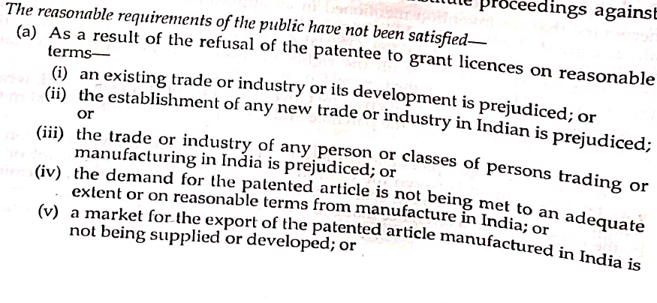
Compulsory License

Slide 134
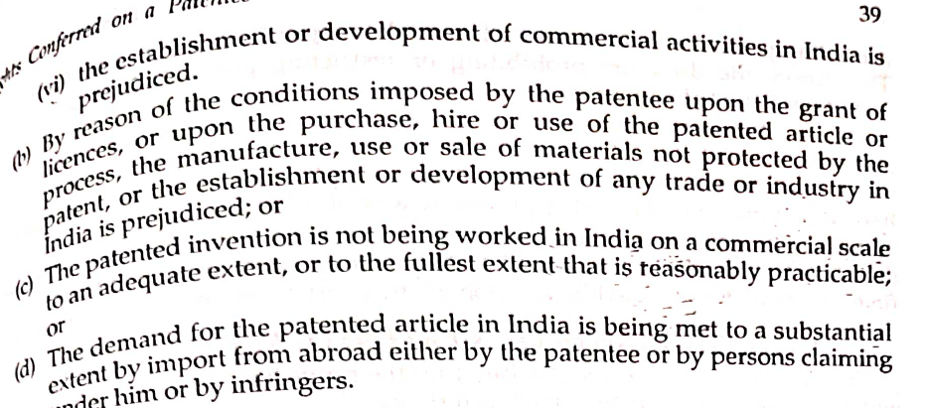
Compulsory License

Slide 135
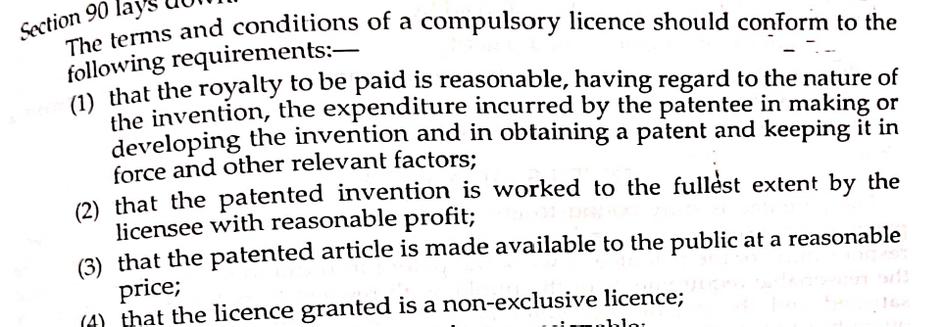
Compulsory License

Slide 136
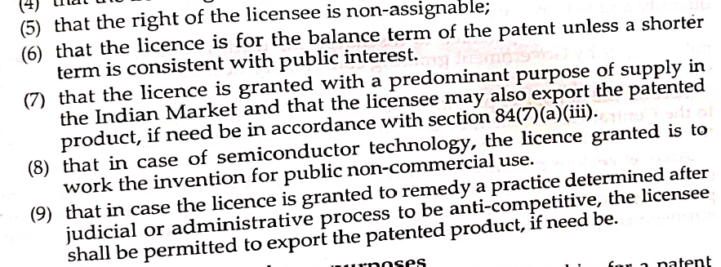
Compulsory License

Slide 137
Case Studies
https://www.thehindubusinessline.com/companies/Indias-first-compulsory-licence-granted-to-Natco-for-Bayers-cancer-drug/article20408026.ece
https://economictimes.indiatimes.com/industry/healthcare/biotech/pharmaceuticals/india-rejects-compulsory-license-application-of-lee-pharma-against-astrazenecas-saxagliptin/articleshow/50652935.cms?from=mdr

